Slide 1
Practical IoT
IoT for smart cities, manufacturing, and Analytics from scratch

Slide 2
Intro Slide

Slide 3

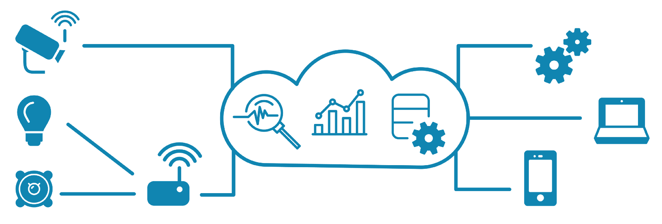
What Comprises the IoT?
Devices
Data Stores
Gateway(s)
Interfaces

Slide 4
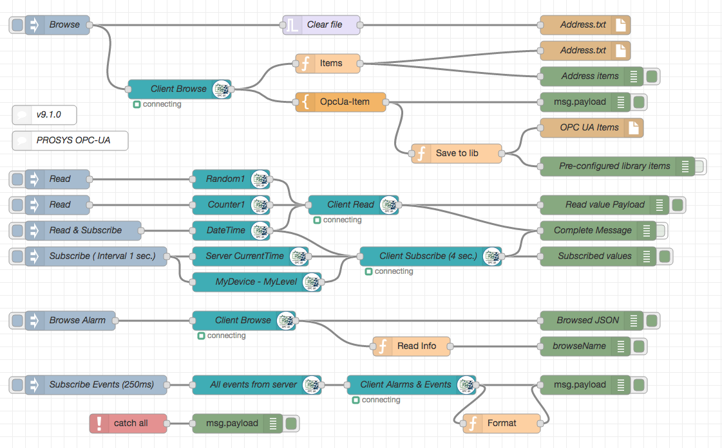
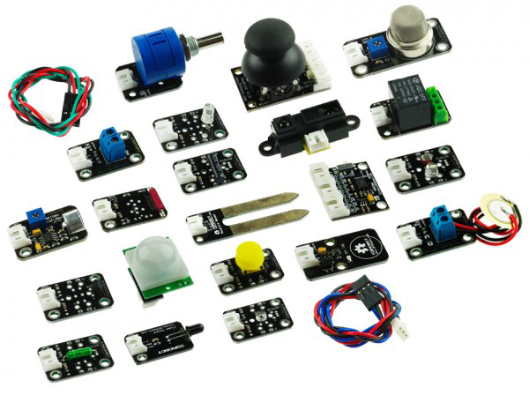


What makes it “SMART”?
STAGE 1: Instrumentation
STAGE 2: Connections
STAGE 3: Analytics
STAGE 4: Pulling it Together

Slide 5
Hardware
Don’t let the smoke out

Slide 6
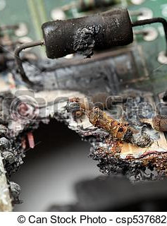
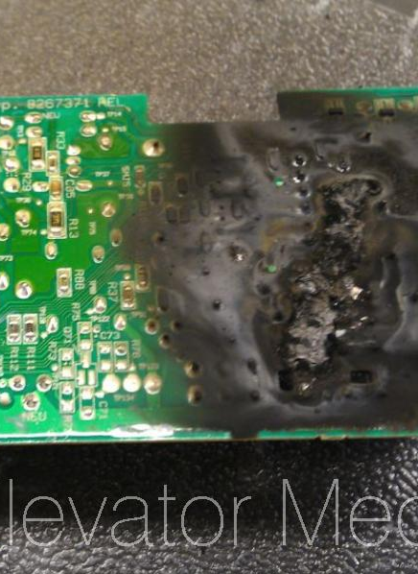
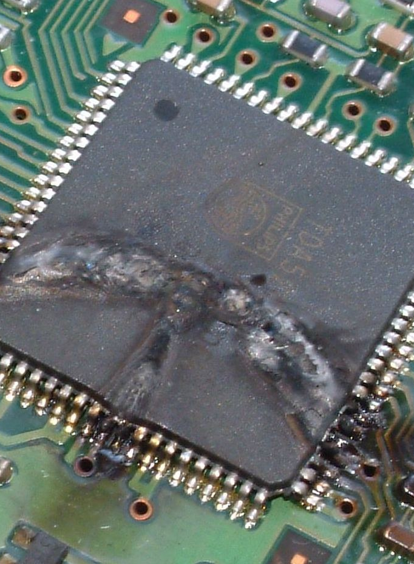
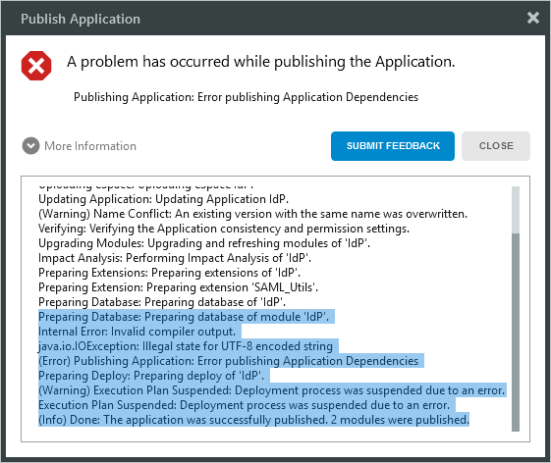

Why is hardware scary?
Software errors are “soft”
Hardware errors on the other hand….
ELECTRICITY KILLS PEOPLE!
Notes:
Getting over working with hardware

Slide 7
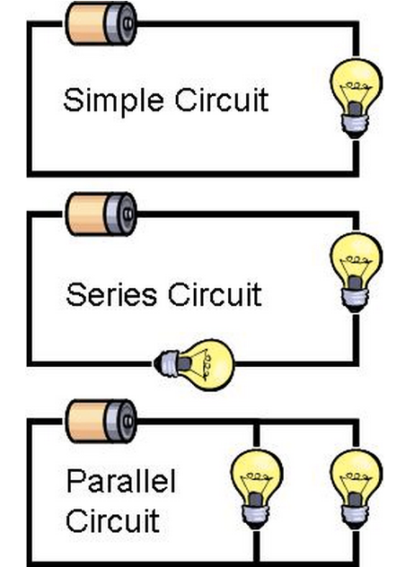
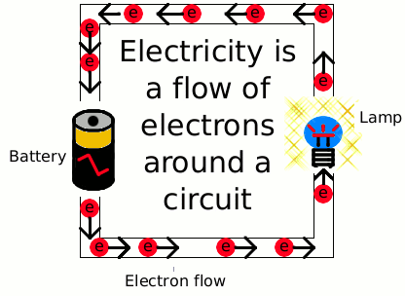
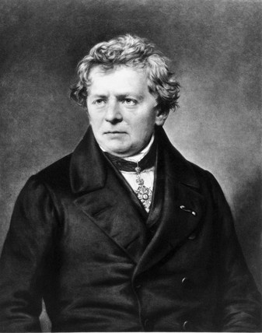

Electricity fundamentals
Electricity is flowing electrons
Flow is channeled through circuits, like water through plumbing
Flow is governed by Ohm’s law:
Voltage (Pressure)
Current (Amperes – same as Speed)
Resistance (Diameter of the pipes)
Notes:
Wiring is a lot like plumbing
Power out or - terminal is the “faucet”
Ground or the + terminal is the “drain”
Ohm did his work on resistance in the years 1825 and 1826, and published his results in 1827 as the book Die galvanische Kette, mathematisch bearbeitet ("The galvanic circuit investigated mathematically").[

Slide 8
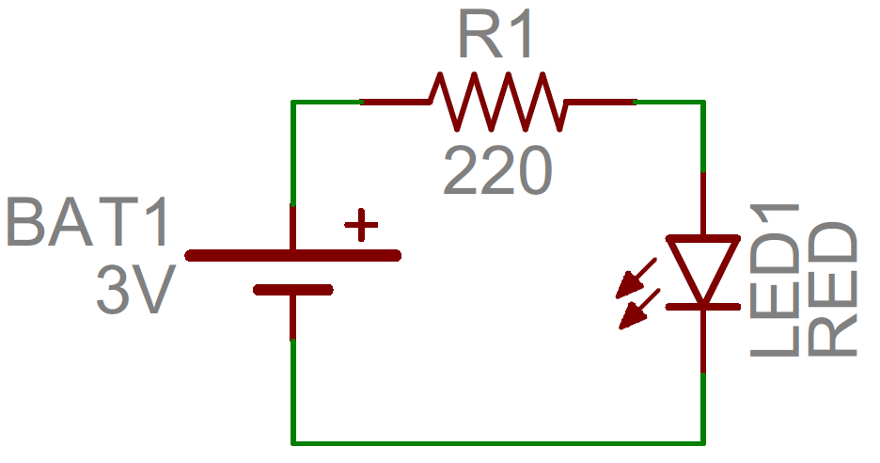

Control Over electricity
To flow, electricity needs a source and a ground
The Pi provides multiple sources and grounds
Note which one your project requires!
All amps are in milli-amps and 3 or 5 V
You are now one of the X-Men
*Inclusion in X-Men adventures not guaranteed
Notes:
Mention the 3v 5v issue with Jerry Bot

Slide 9
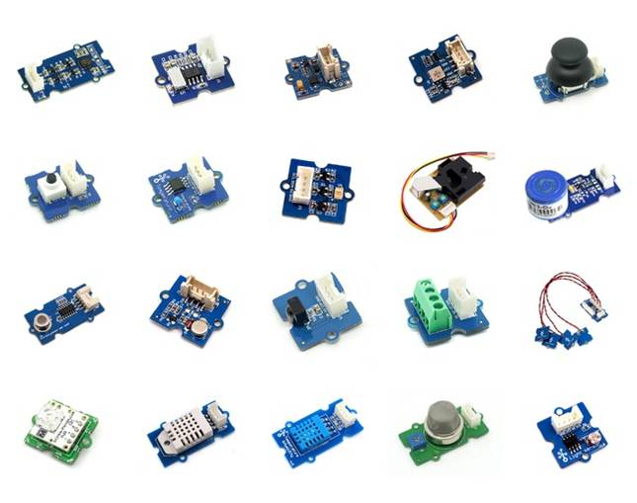
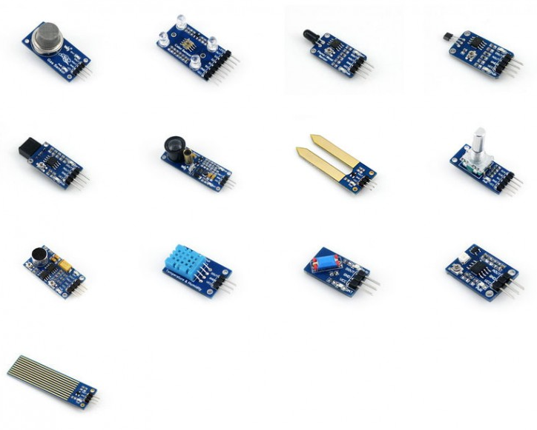
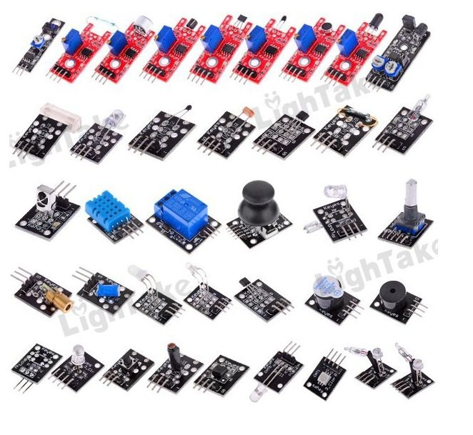
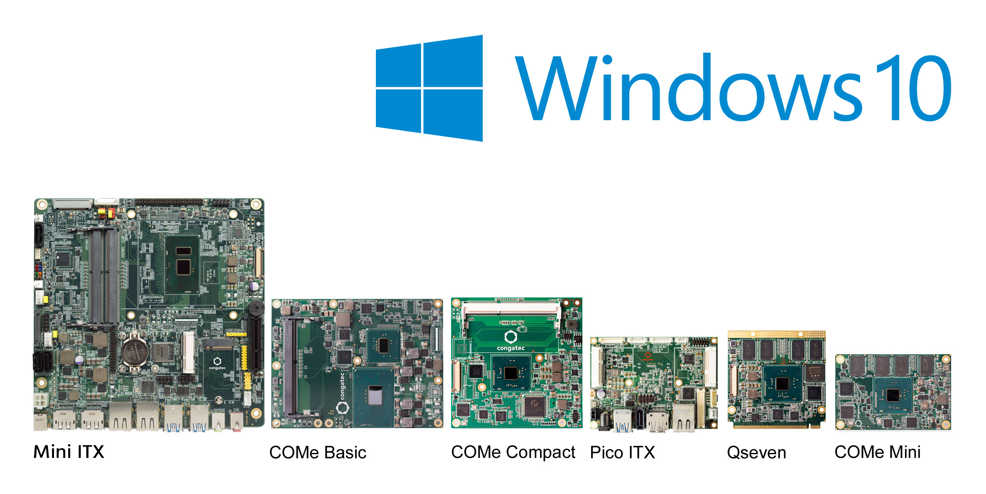
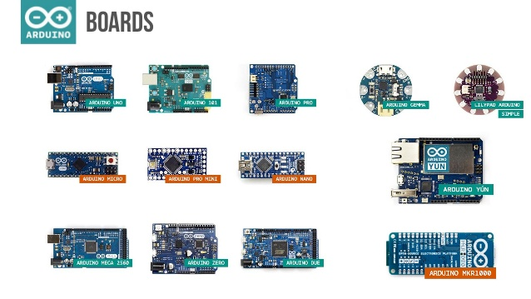
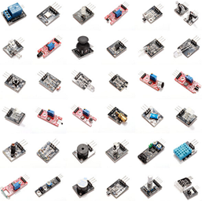
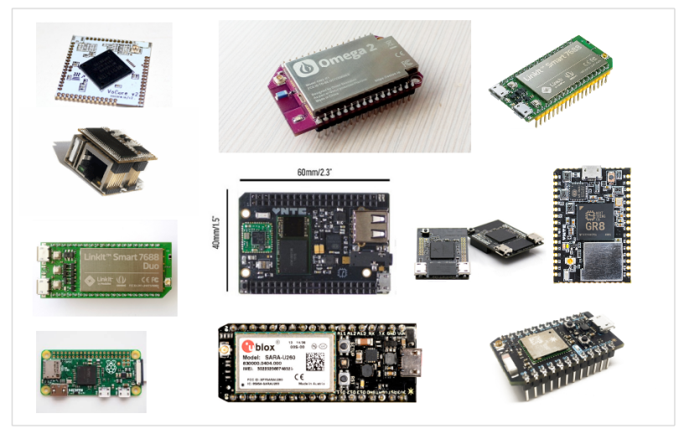
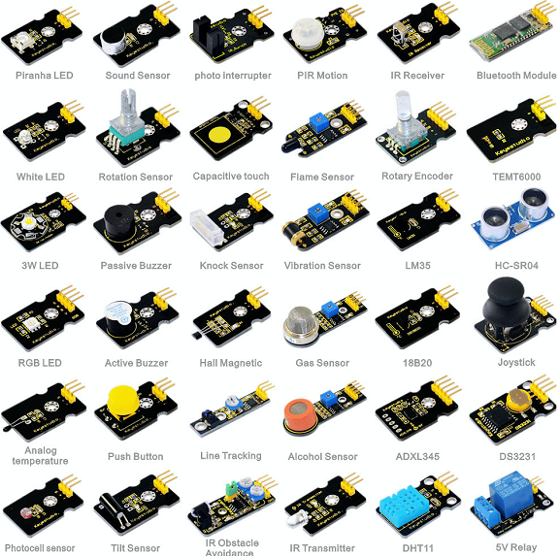
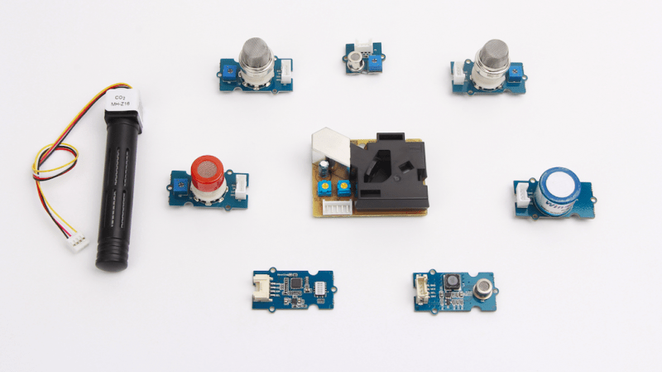
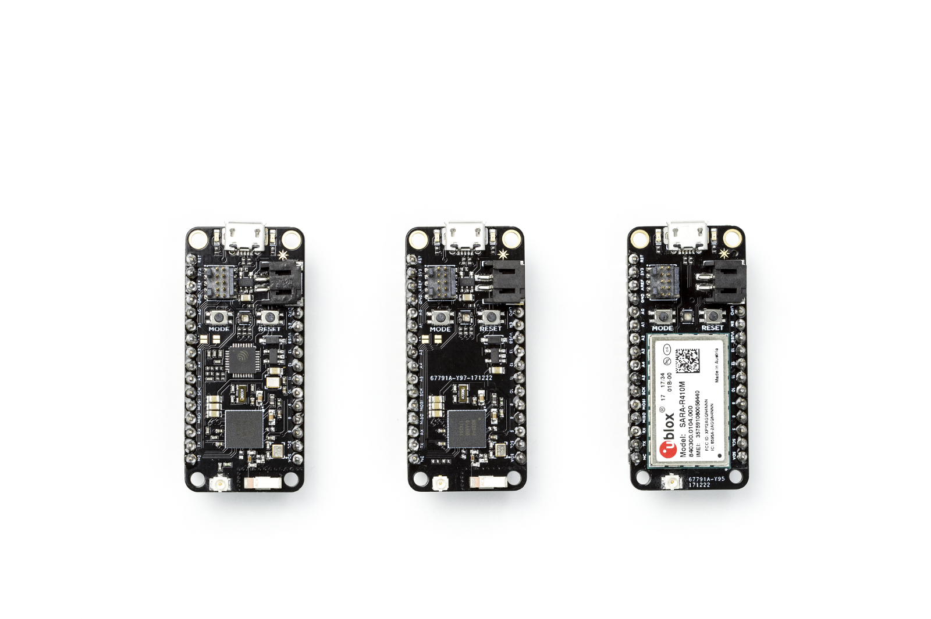
Hardware Overload
Notes:
Second reason hardware is kind of challenging? Where do you start?

Slide 10
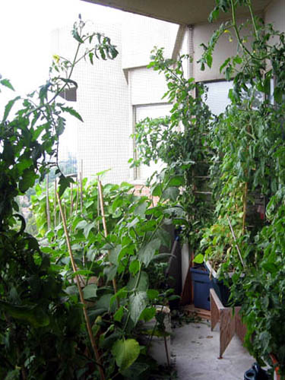
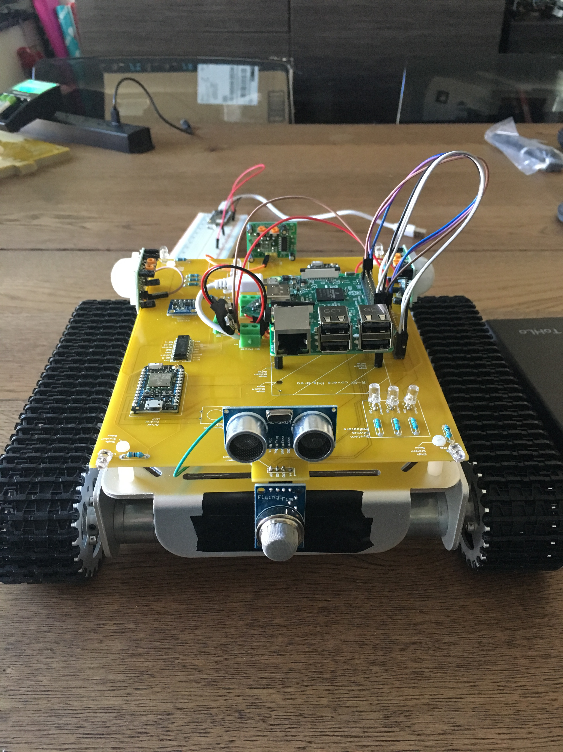

Pick a Project first!
Simplify your selection process
Helps you chose the right platform
Clarifies how to get to the end state

Slide 11
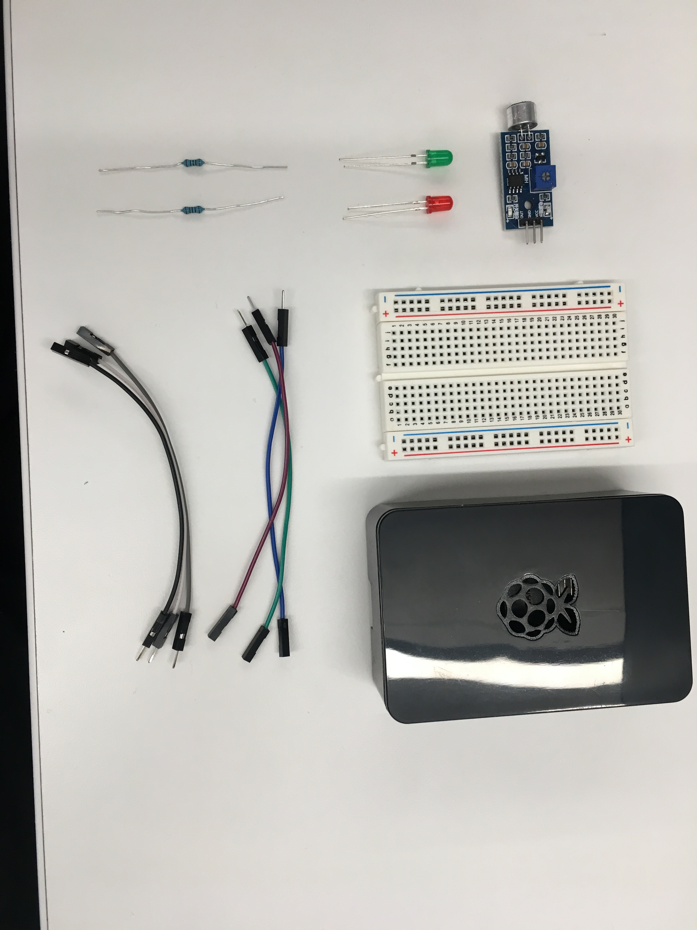
OUR Hardware – AKA What’s in this box?
Basic hardware required to build our project
Breadboard
Wires
Lights
Resistors
Sensor
Raspberry Pi 3

Slide 12
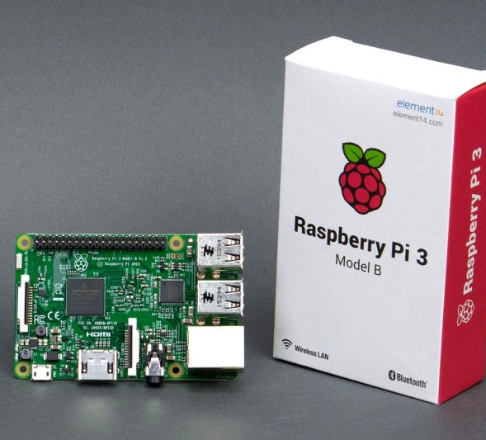
Node MCU (esp8266)
Why esp8266?
Inexpensive
Digital and analog
Fast!
Power Consumption
Size
Built-in Wireless
Why NOT esp8266?
C

Slide 13
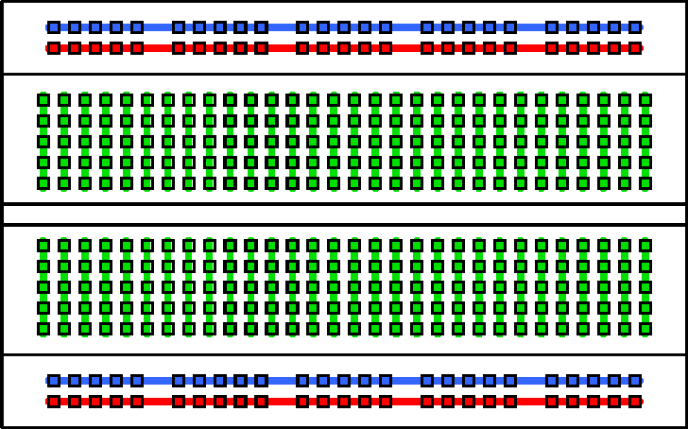
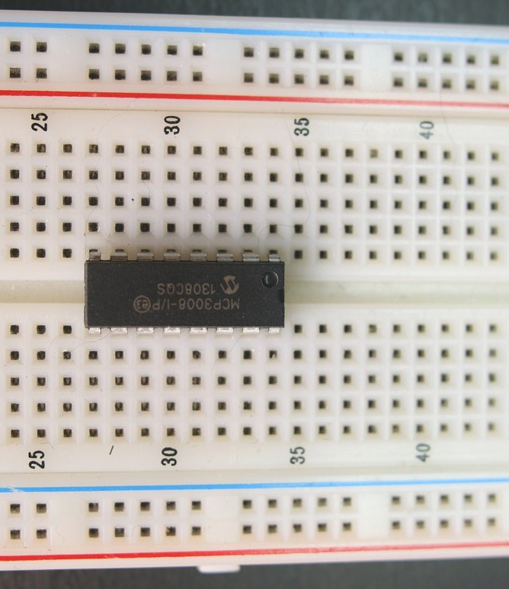
Breadboard basics
IC Chip
Terminal Strips
Columns (#’s)
IC Chip “Ravine”
Rows (Letters)

Slide 14
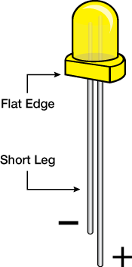
Resistors and LEDs
Notes:
Resistors reduce flow by introducing resistance to the electrical current
Graded in value of that resistance (OHMS)
Governed by Ohms law
LED lights make light through magic – small leg is the Ground side

Slide 15
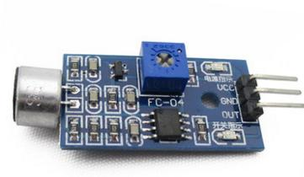
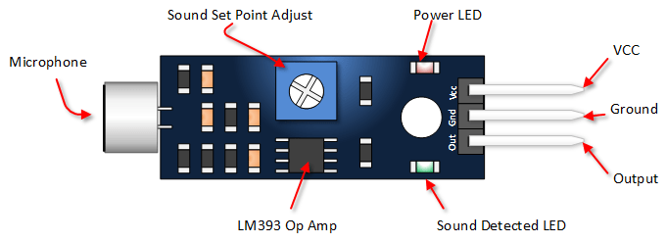
SENSOR Basics
Common Sensor pinout:
VCC = power IN
GND = power OUT (Ground)
Out(put) = signal out
Sometimes you get:
A0 = Analog output
D0 = Digital output

Slide 16
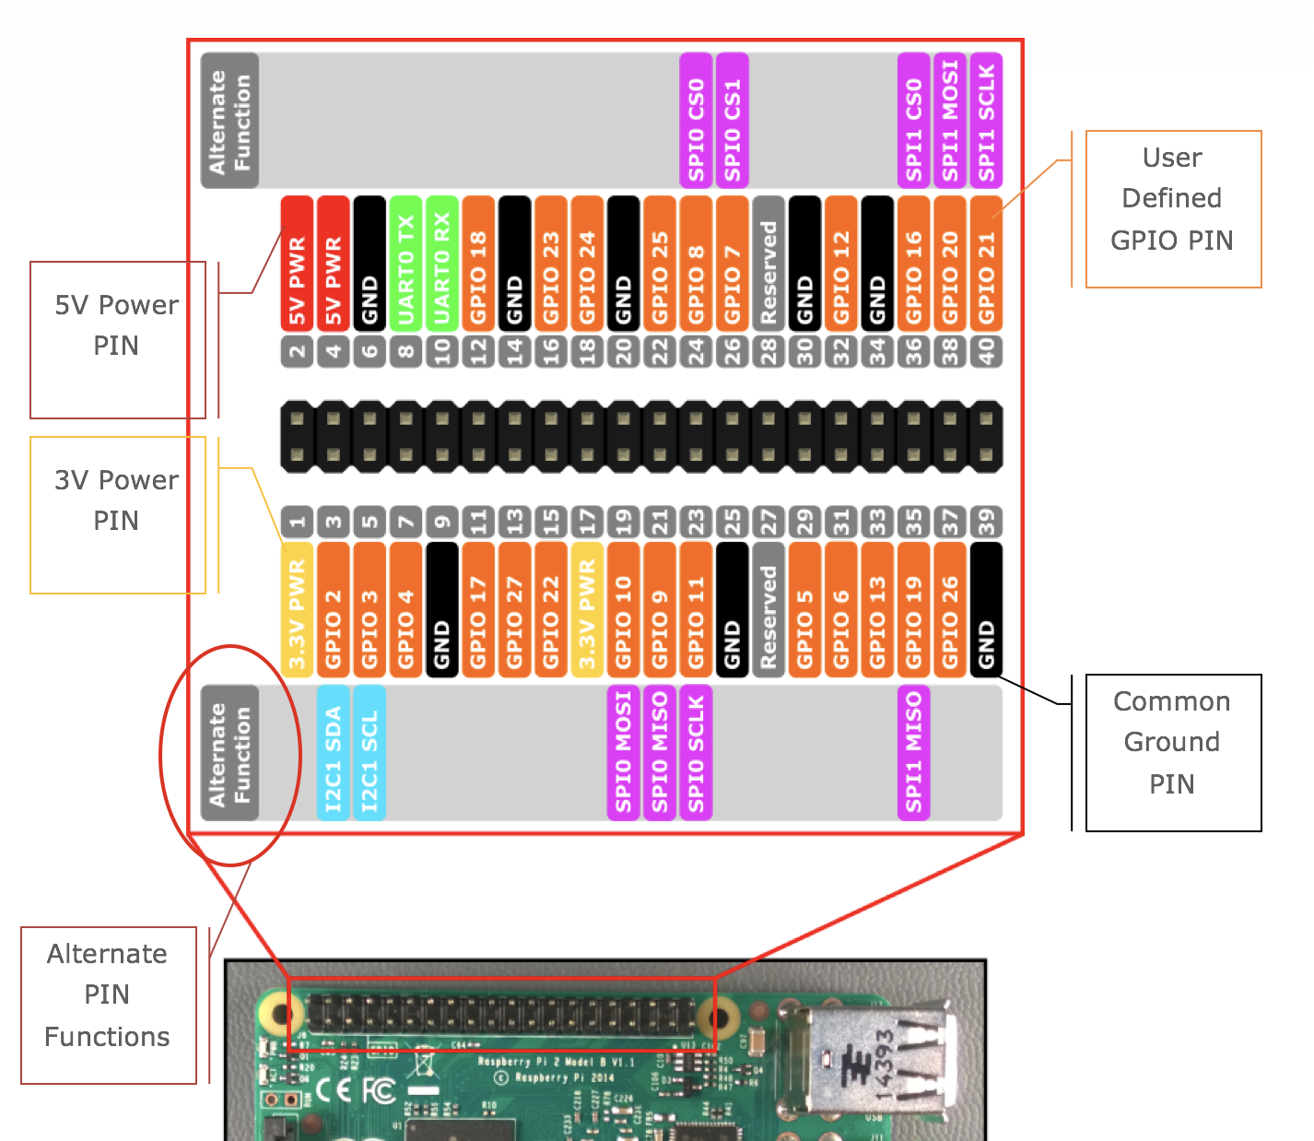
A pinout ‘splainer
Power
Ground
GPIO
Alternate Functions
Notes:
Page 7 in the companion
Refer back to the electricity slide – every one of these pins is effectively a battery “-” sign – some are on all the time and some you control. They can go in or out.

Slide 17
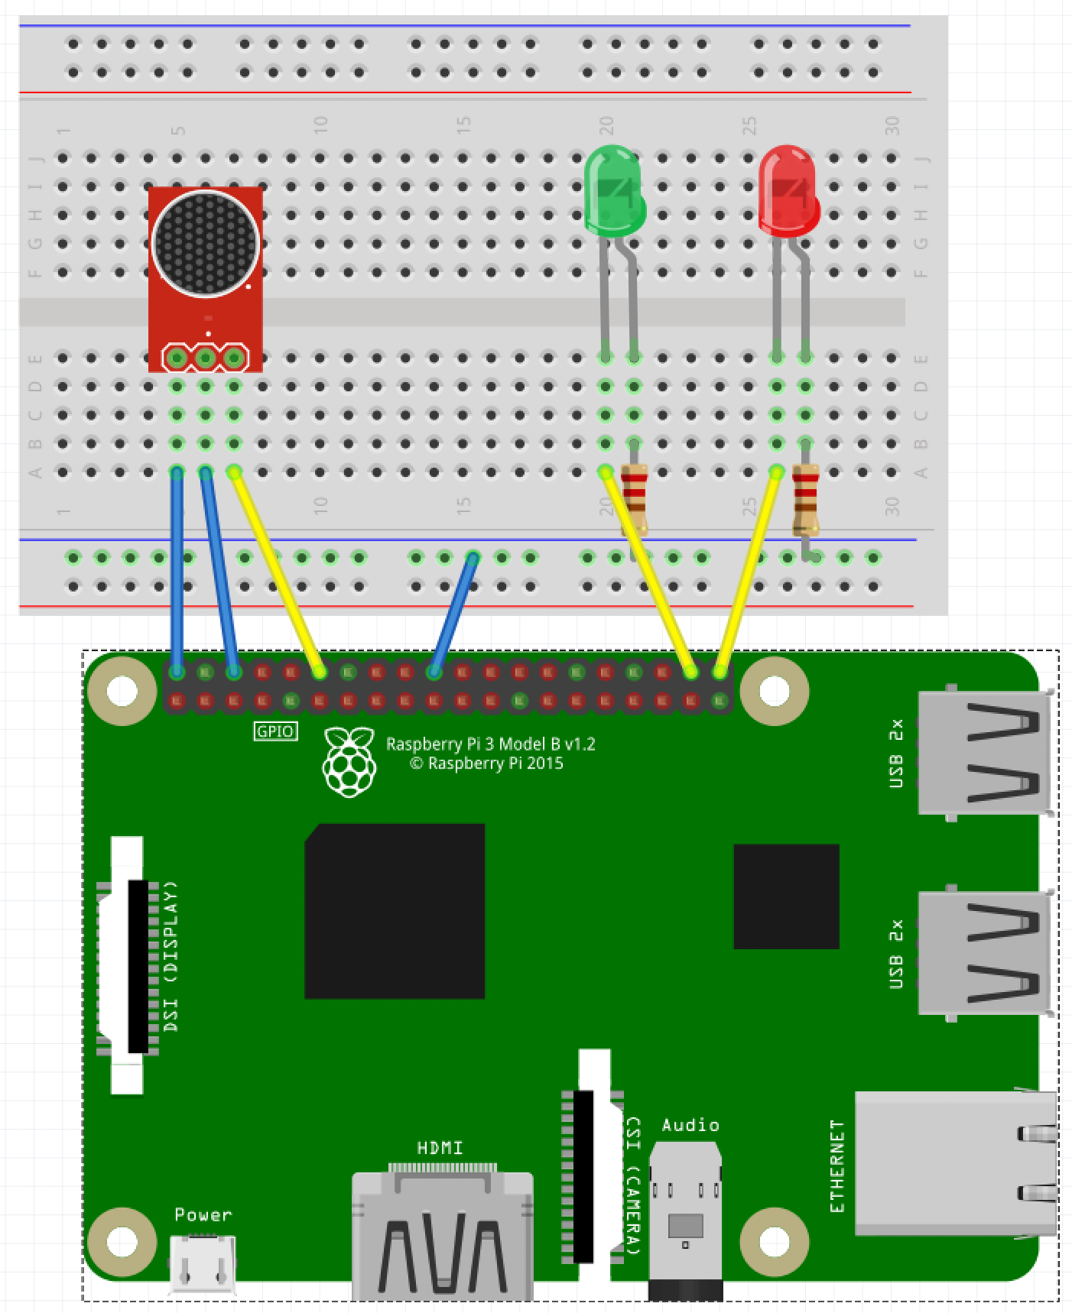
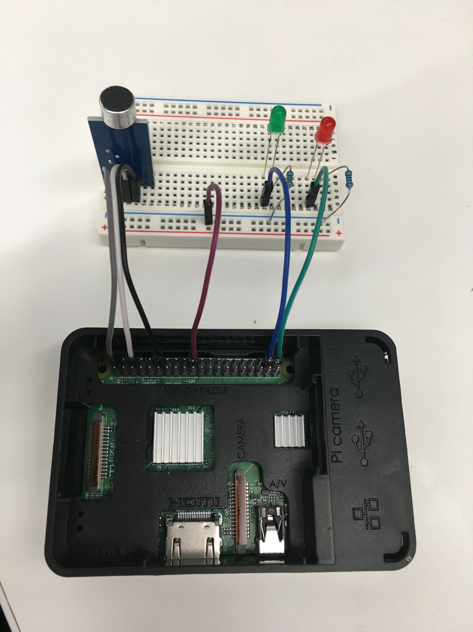
Slapping it all together
KISS – keep it simple, son!
Notes:
During the build, talk about things like:
Prototype vs commercial
Screwing around versus functional building
Long-term things you can do to get serious

Slide 18
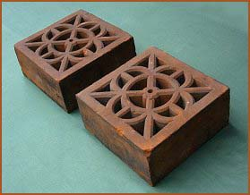
Now we have a Fancy Brick
It looks cool!
It matches the picture
It doesn’t do anything
Yet!

Slide 19
Take 15 minutes to RECOVER!

Slide 20
Software
It’s easier from here!

Slide 21
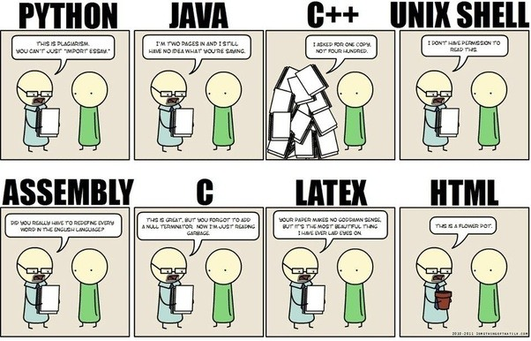

IoT (often) Requires MANY languages

Slide 22


Let’s Review the code!

Slide 23
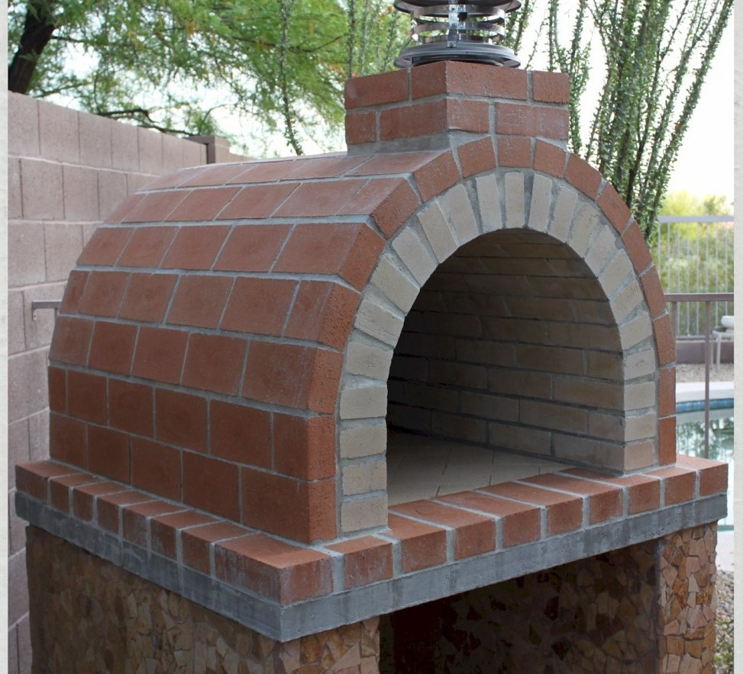
You have now made a brick oven!
It serves a functional purpose
It doesn’t just sit there
It works like you coded it to!

Slide 24
The Stage 2 Smart City
Working together

Slide 25
Simulating an intersection

Slide 26
What’s Next?

